Slide 1
DOM &web element locators

Slide 2
Learning Objectives
By the end of this lecture, you should be able to:
Explain the DOM structure and its relationship with HTML web pages.
Inspect web elements and their attributes using browser Developer Tools.
Identify and apply ID, Name, Class, Link Text, XPath, and CSS Selectors.
Construct reliable locators for Selenium WebDriver automation.
Debug and resolve common web element locator issues.

Slide 3
Understanding the DOM
DOM = Document Object Model
DOM: The Structure Behind Every Web Page
The DOM is a programmatic representation of an HTML page that allows tools like Selenium to find and interact with elements.
Think of it as:
  HTML Code → DOM → Web Page
Imagine a university building:
  Building → Web page
  Rooms → HTML elements
  Room numbers/names → Attributes such as id, name, class
  Connections between rooms → Parent-child relationships
Selenium doesn't "see" the page like a human. It interacts with the DOM.

Slide 4
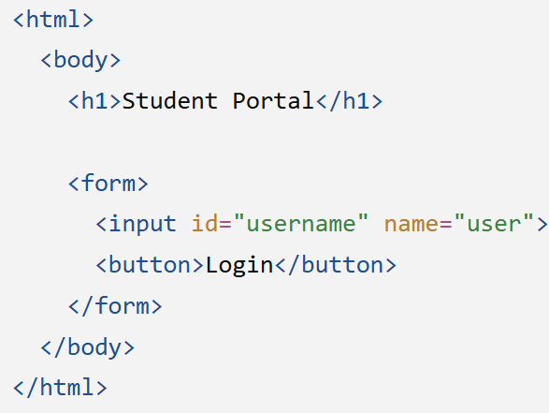
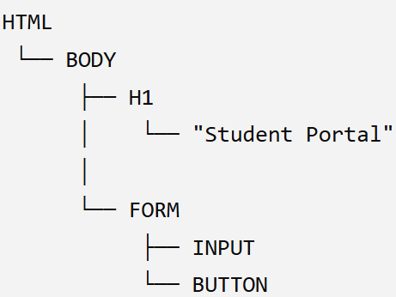
HTML → DOM → Web Page
Consider this HTML:
The browser reads this HTML and creates a DOM tree:
The HTML is the source structure, while the DOM is the browser's structured representation of that document.

Slide 5

What is an HTML Element?
An element is a component of a webpage.
Consider this HTML:
Here:
  Tag / Element Type: button
    Defines what type of HTML element it is
  Attribute: id="loginBtn"
    Provides additional information that can help identify the element
  Text / Content: Login
    The visible text contained within the element
  Complete Element: <button>Login</button>
    Consists of the opening tag, content, and closing tag

Slide 6
Common HTML Elements
<input>
<button>
<a>
<h1>
<p>
<img>
<form>
<div>
Selenium locates these elements and performs actions on them.

Slide 7
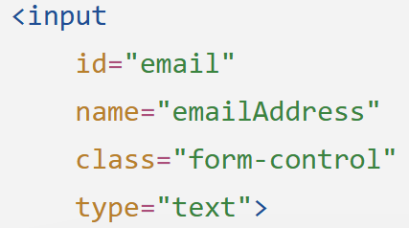
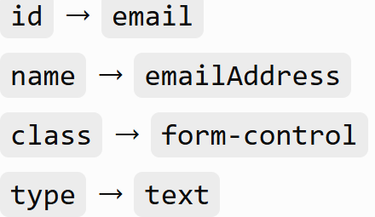
Elements Have Attributes
Attributes provide additional information about an element.
This element has:
Why do testers care?
  Because attributes can help us create locators.
  For example:
    driver.findElement(By.id("email"));

Slide 8
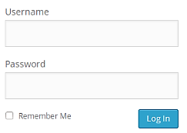
Why Does DOM Matter in Selenium?
Suppose a user sees:
A human simply thinks: "Click Login."
Selenium needs something more precise: driver.findElement(By.id("loginBtn")).click();
So Selenium needs to answer: "Which exact element do you mean?"
That's why we need Web Element Locators.
DOM tells us what exists.
Locators tell Selenium how to find it.

Slide 9
Developer Tools: See What Selenium Sees
Try it yourself
  Open a webpage.
  Right-click a button.
  Select Inspect.
  Find the corresponding HTML element.
  Identify:
    Tags (<p>, <div>, <a>, etc.)
    Attributes (id, class, href, etc.)
    Text
Key question?
  If I want Selenium to click this button, what information could I use to identify it?

Slide 10
Selenium Webdriver and DOM
The role of the Selenium WebDriver is a two-way-communication with the browser DOM, i.e. WebDriver passes commands to the browser and receives information back. This is done via the browser-specific driver (e.g. ChromeDriver).
Web elements in the DOM are type cast to WebElement objects by the WebDriver and located using the findElement() method.
  This method takes a locator as its argument and searches through the DOM until a match is found. If no match is found a null value is returned.

Slide 11
Locating Web Elements in Selenium
How to Locate Web Elements: Selenium uses different methods to find and interact with web elements.
Locator: A locator can be an ID, name, class name, CSS selector, or XPath expression.
  Using a locator, you can instruct Selenium to find a web element and perform an action on it, such as clicking a button, filling out a form, or selecting an option from a drop-down menu.

Slide 12
Types of Locators
Refer to the MS Word Document “Types of Locators” for detailed explanation and practice.

